Slide 1
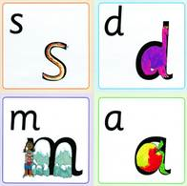
Reception Parents Phonics Meeting 27th September 2019

Slide 2
Read, Write, Inc.
‘Read, Write Inc.’
This is the Phonics programme by Ruth Miskin.
This happens in Nursery, Reception, Year 1 and Year 2 for 20 minutes every day.

Slide 3
Teaching Sounds
The first thing we teach children is the correct pronunciation of sounds. This prevents children from reading and writing words incorrectly.
We call these sounds ‘pure’ sounds.
http://www.ruthmiskin.com/en/resources/sound-pronunciation-guide/
These need to be pronounced correctly to avoid the children spelling words incorrectly e.g. children may incorrectly write words as ‘fuh’ instead of ‘f’.

Slide 4
Special Friends
As children progress through the programme they will be introduced to some sounds that are represented by two or three letters. These are called digraphs (two letters) and trigraphs (three letters). The children may refer to these as ‘special friends’ as they like to be together.
shop
ship

Slide 5
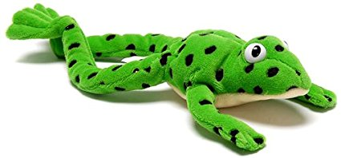
Meet Fred!
Fred can only talk in sounds...
He says “c_a_t.” and the children then blend (combine the sounds) to read and reveal the word.
We call this Fred Talk.

Slide 6
Key phrases…
Green Words – words that can be sounded out using our phonics
Red Words – words that cannot be sounded out e.g. I, said, was
Fred Talk – (Fred is the frog) he can only talk in sounds e.g. sh-o-p

Slide 7
Reading Records
Reading records are essential for communication between school and home. It is important that you teach your child to take care of their Reading Record and reading books, bringing them into school each day.

Slide 8
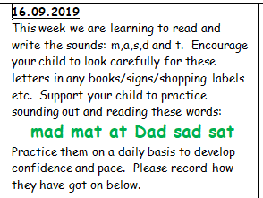
Phonics Overview
Each week your child will come home with an overview of what sounds/words they have been learning in class. It will benefit your child to practice these sounds/words in a fun way on a regular basis.

Slide 9
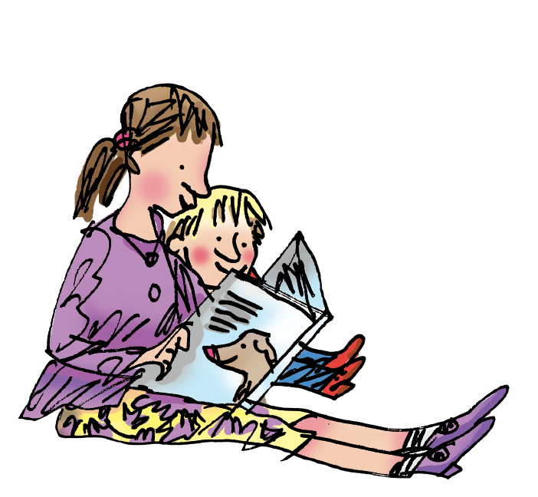
How to help your child at home…

Slide 10
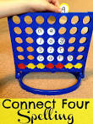
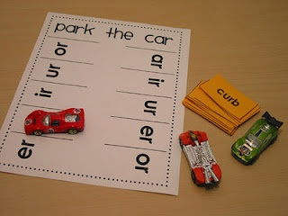
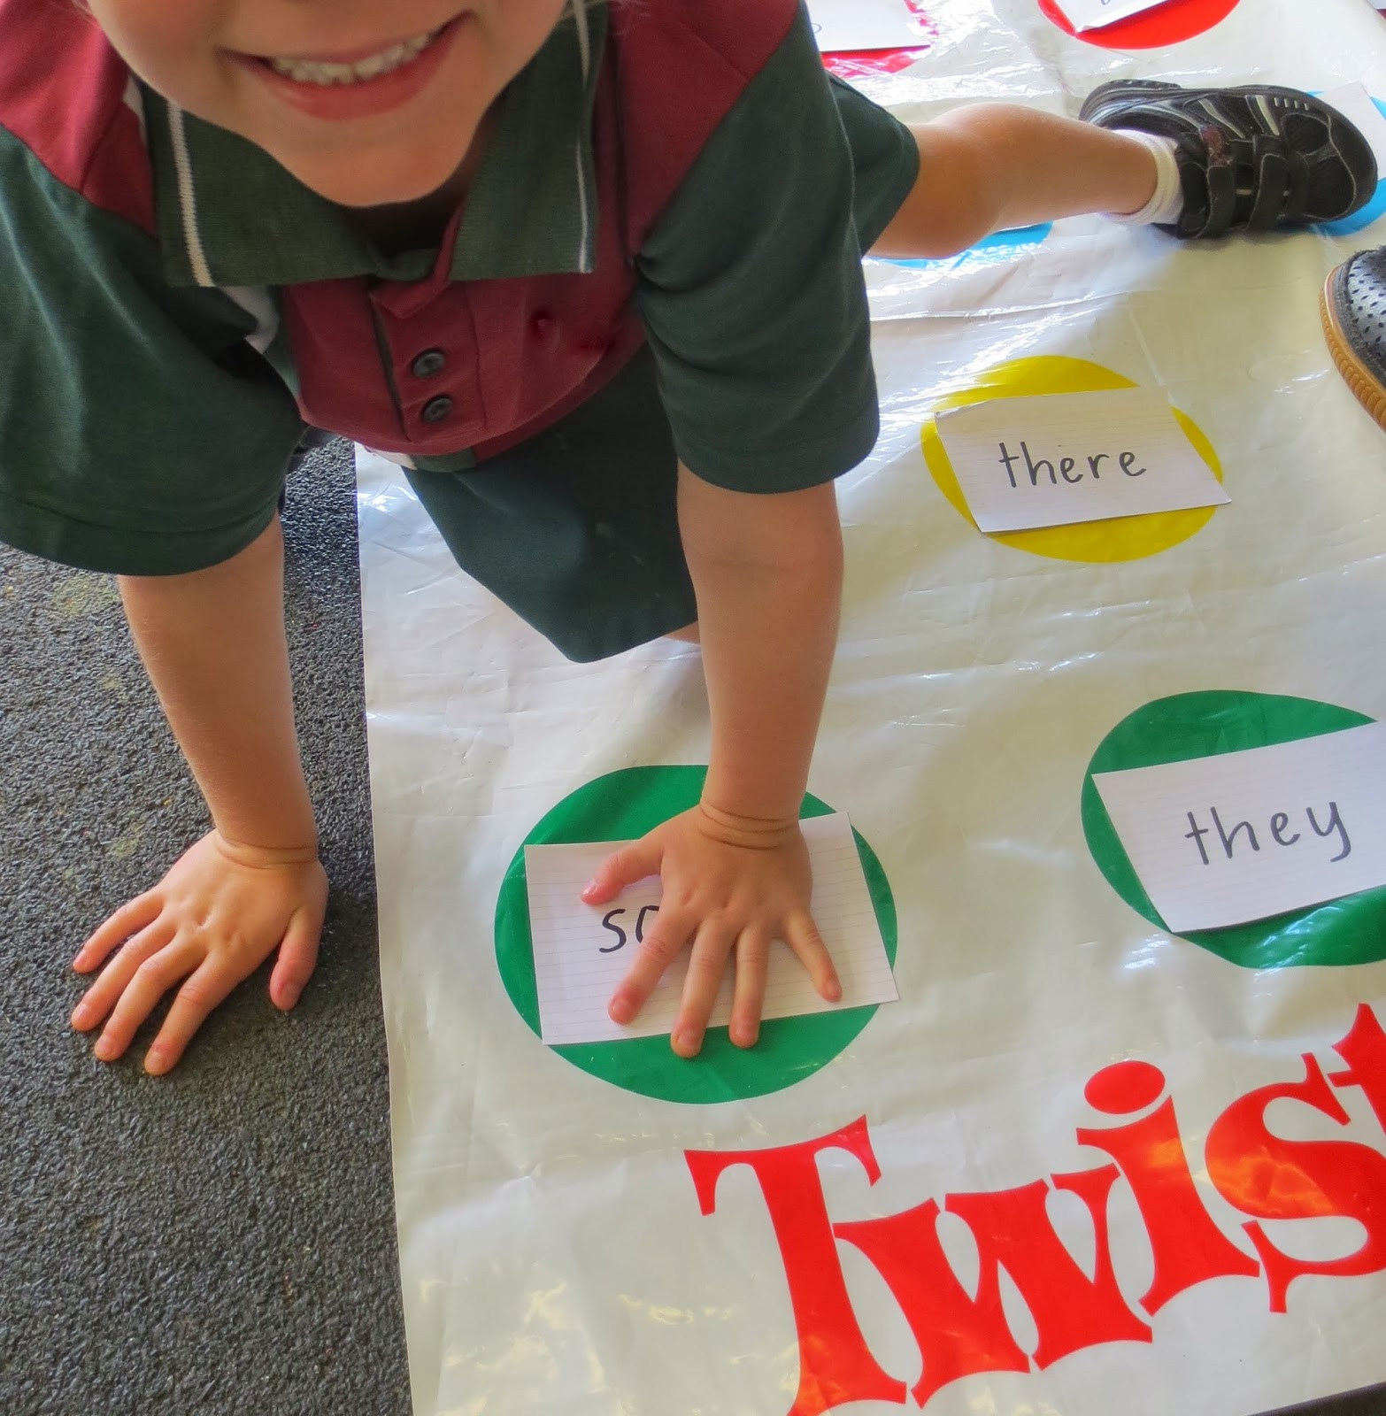
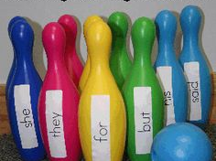
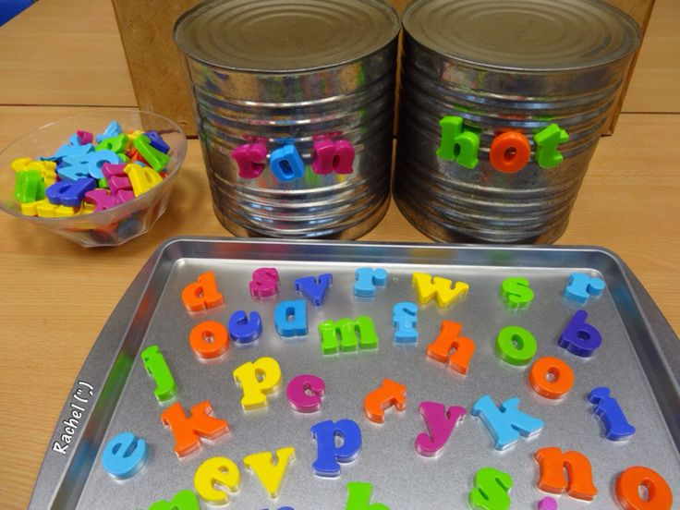
Try this at home...

Slide 11
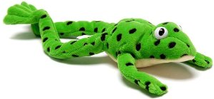
Have fun with Fred Talk.
“What a tidy r-oo-m!”
“Where’s your c-oa-t?”
“Time for b-e-d!”

Slide 12
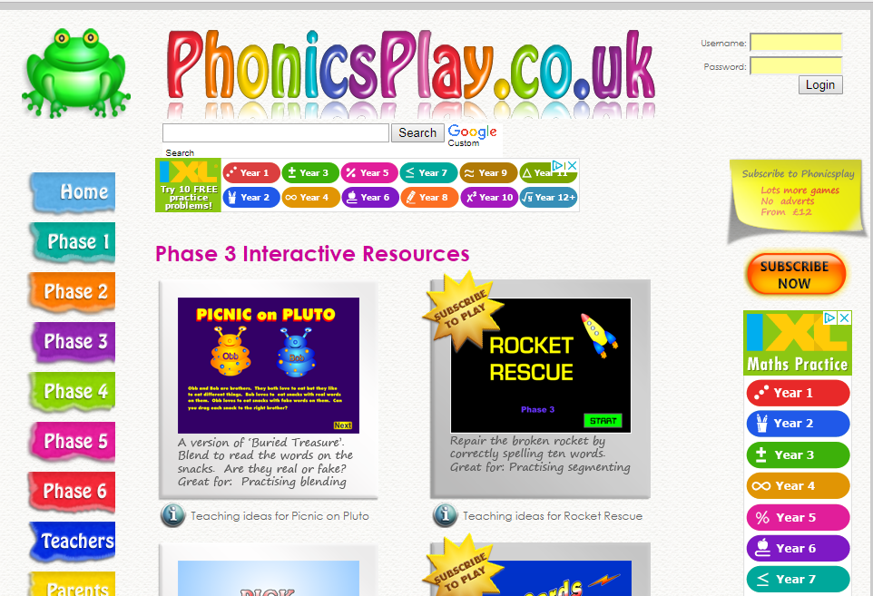

Slide 13
Useful Websites
Mr Thorne – Geraldine the Giraffe
www.phonicsplay.co.uk – Free Phonics Play
www.lettersandsounds.com
www.ruthmiskin.com – Read Write Inc Phonics

Slide 14
Please remember:
Short regular reading is much better than one long period.
Reading opportunities are everywhere- encourage your child to read labels, captions, signs, food packets, magazines and books etc.
Make reading enjoyable, children gain lots from listening to you read too.
Make time to discuss the story, these discussions form the basis of all comprehension skills.

